Slide 1
Machine Learning based Intelligent Traffic systems
GROUP 19, BTP PRESENTATION

Slide 2
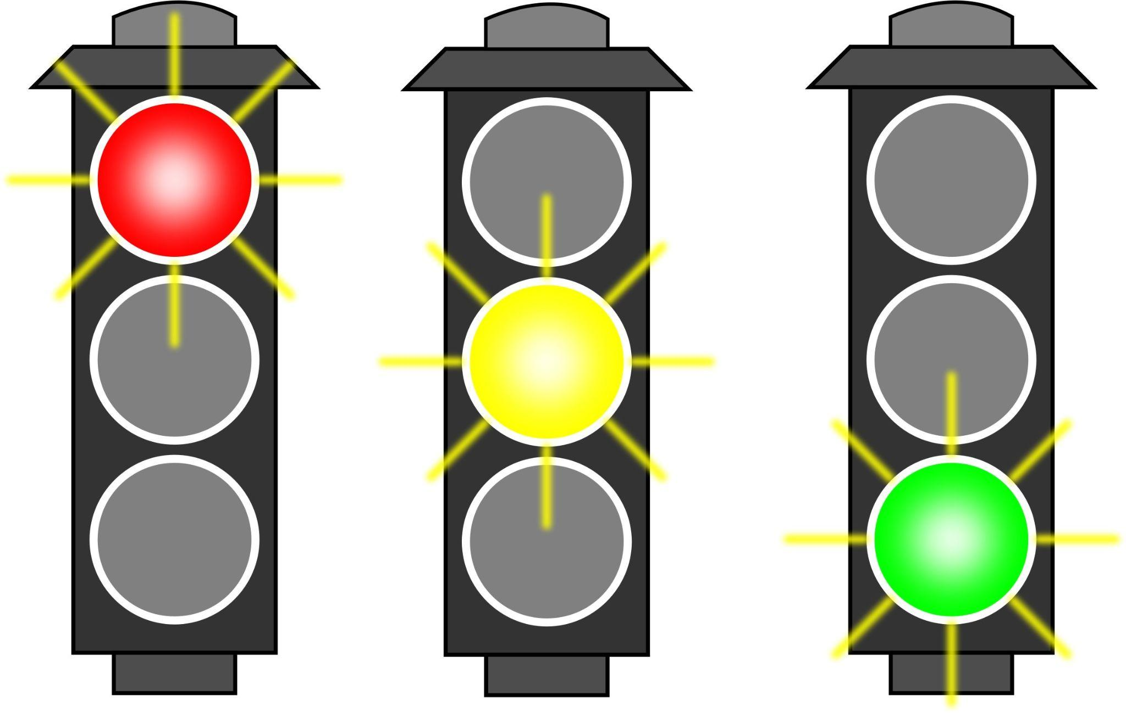
Project Advisor:
Jayanarayan Thakurdas Tudu
IT’S BETTER TO WASTE MONEY THAN TIME, YOU CAN ALWAYS GET MORE MONEY.
Presented by:
CS18B001 AVS Hrudai
CS18B004 B.Akshitha
CS18B019 Likhith Raju

Slide 3
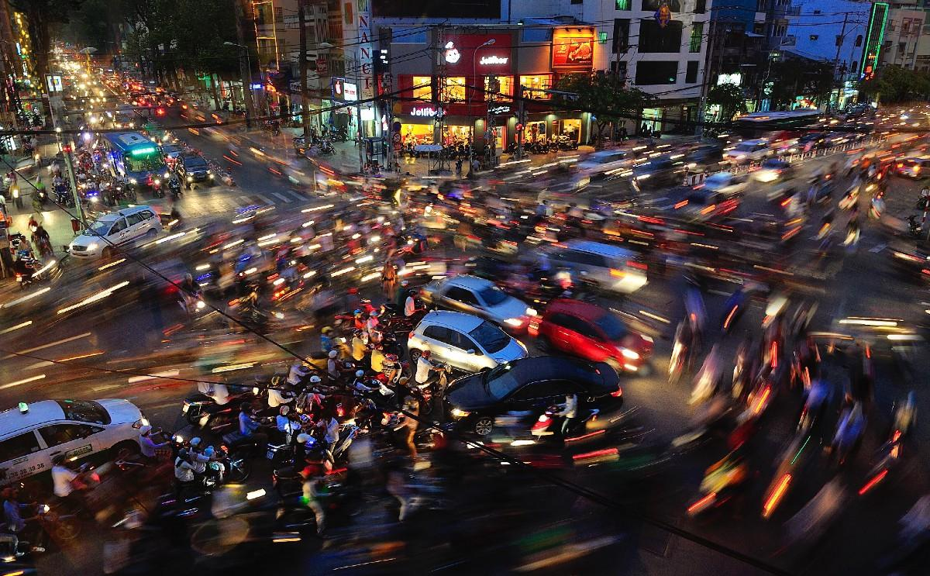
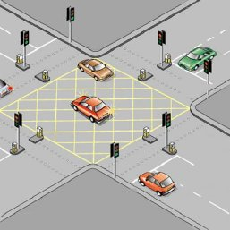
1 PROBLEM STATEMENT :
People waste lot of time commuting to work, school, shopping, and social events dealing with traffic lights. Ambulances and emergency response vehicles (police, fire, etc.) are stuck in horrendous traffic jams. Traffic is constantly congested in all directions on key routes, whether its before, during, or after working hours.Even if there are other options are available and usable, automotive transportation will be required at some point along the trip.

Slide 4
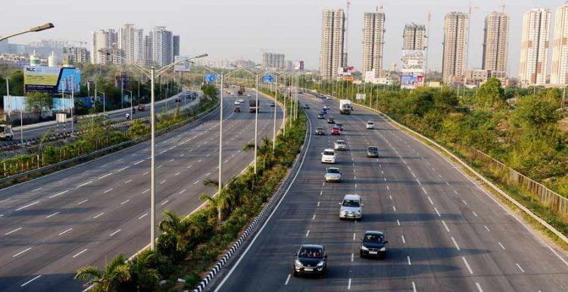
1.1 PROBLEM STATEMENT :
As a result, traffic congestion develops. The majority of traffic signal systems use a timing mechanism that switches the lights after a predetermined time. In some situations, this may be ineffective. There is no input from the controlled variable (traffic volume) to the controller because the timed control mechanism is an open loop control system (traffic control system using lighting). For example, whether the road is crowded or not, the duration of the green light will always be the same.
Minimize the Traffic congestion on Road
Detect Vehicles
Count lanes and vehicles on each lane
Signal switching - 2 approaches
Output in timer and light.

Slide 5
2 ROADMAP :
Read Research Papers on existing Traffic Systems
Understanding YOLO v3,v4 Software and Testing data Sets
Integrating The software and hardware
1
3
5
2
4
6
Discussion on flaws and inferences from indian Traffic System
implemented a congestion based dynamic timer for traffic lights.
Potential Bug fixes and end release

Slide 6
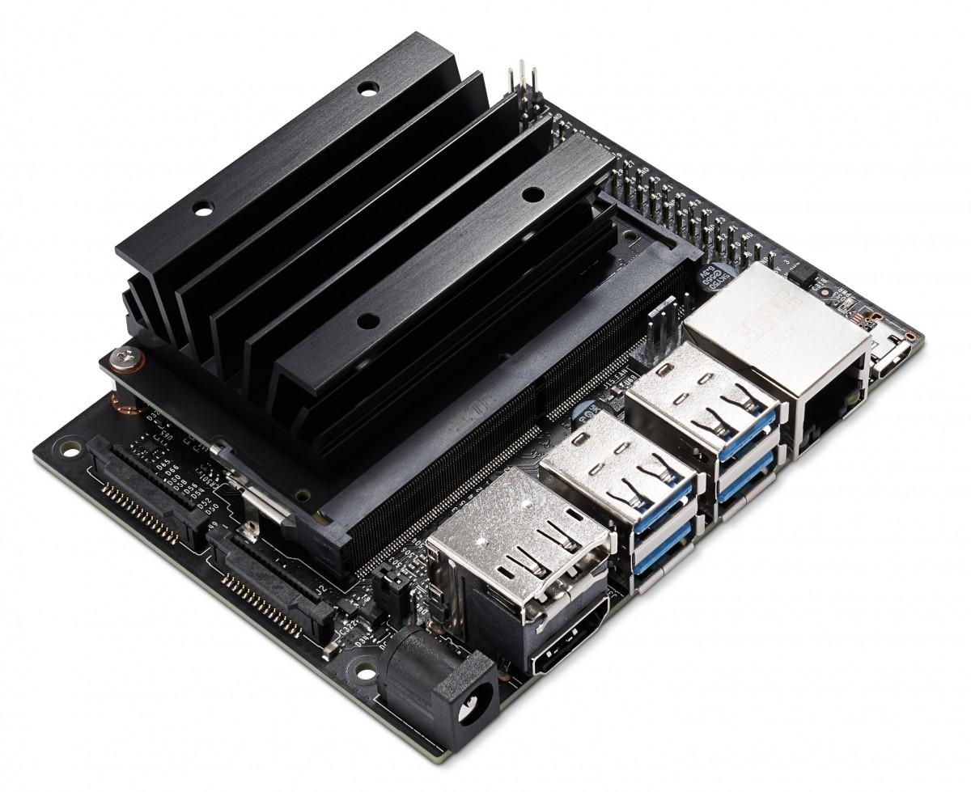
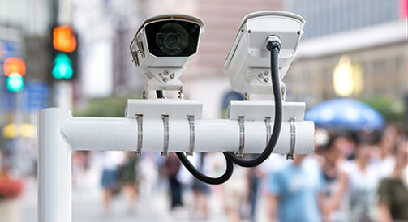
3 PLAN FOR EXPERIMENTAL SET-UP :
Hardware components :
Camera
Nvidia Jetson Nano(4GB)
Software :
YOLO v4 on
1)Jetson for 2 lane camera
2)Google colab for 4 lane
We use a specialised camera setup at the Crossroads (junction) which can give live video input to the hardware module, which later process the video through yolo and gives the data of number of vehicles/density of vehicles on each lane to signal switcher program which analyses this data and decides which lane to give priority to, at abnormal data conditions like all lanes have same density the the model reverts back to general traffic signalling and once the situation is taken care of it gets back to the signal switch program and adjusts both the signal and the timer.

Slide 7
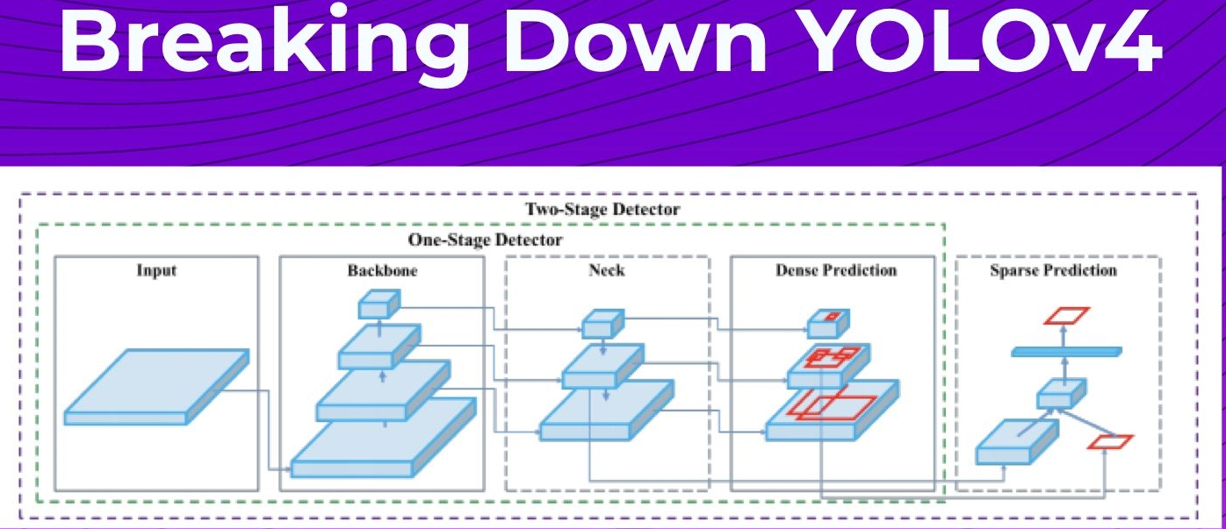
4 IMPLEMENTATION :
1. Machine learning model setup and development.
2. YOLO Machine learning model training and weight creation.
3. Vehicle detection and counting of vehicles by YOLO model.
4. OUTPUT as vehicles in lane
5. Input to Dynamic Signal Switching python file.
6. Output as Traffic Lights and timer

Slide 8
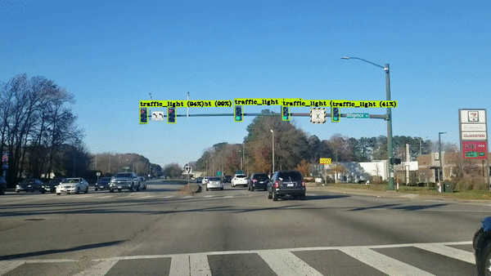
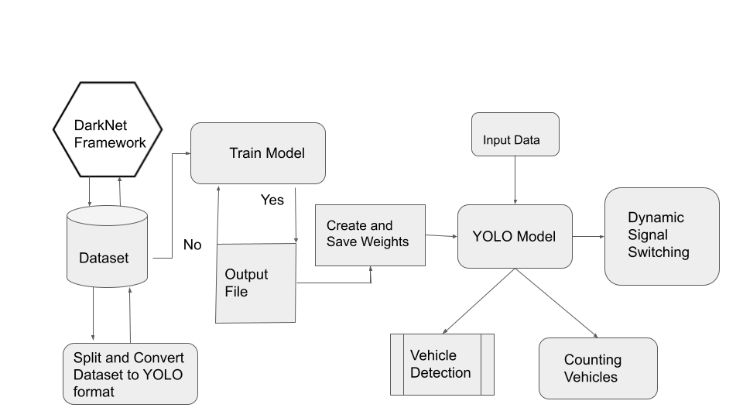
4.1 IMPLEMENTATION :
FLOW DIAGRAM:

Slide 9
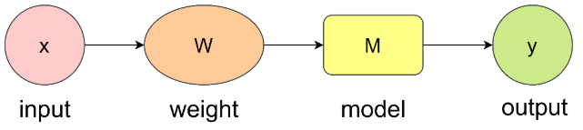
5 VEHICLE COUNT & WHY YOLO ? :
YOLO V4:
Biggest advantage of YOLO Model, when compared to the rest of the algorithms is, it’s speed.
Network understands generalized object representation (This allowed them to train the network on real world images and predictions on artwork was still fairly accurate).
Open-Source Machine Learning Model

Slide 10
6 DYNAMIC SIGNAL SWITCHING :
Steps in dynamic signal switching:
• Signal Open/Close Time.
• Lane Open/Close Function.
• Dynamic to Static at abnormal conditions.
Collected data is delivered to the computer system as out.txt, where we’ve created a Python software to interpret the data and have previously set a threshold value based on the number of vehicles.
The system decides the priority of each lane when it comes to signal opening. If no cars or the same number of vehicles are detected in each lane, the model will switch to a static signal switching strategy.

Slide 11
7 SYNCHRONIZATION OF TIMERS :
Code:Synchronization logic & steps in dynamic signal switching:
f = open("out.txt", "r")
no_of_vehicles=[]
no_of_vehicles.append(int(f.readline()))
no_of_vehicles.append(int(f.readline()))
no_of_vehicles.append(int(f.readline()))
no_of_vehicles.append(int(f.readline()))
baseTimer = 120 # baseTimer = int(input("Enter the base timer value"))
timeLimits = [5, 30] # timeLimits = list(map(int,input("Enter the time limits ").split()))
print("Input no of vehicles : ", *no_of_vehicles)
t = [(i / sum(no_of_vehicles)) * baseTimer if timeLimits[0] < (i / sum(no_of_vehicles)) * baseTimer < timeLimits[1]
else min(timeLimits, key=lambda x: abs(x - (i / sum(no_of_vehicles)) * baseTimer)) for i in no_of_vehicles]
print(t, sum(t))

Slide 12
7.1 ITLC ALGORITHM FORMULATION :
The ready area is a virtual defined area around each road intersection.The boundaries of each ready area are set based on the maximum allowable green time of the traffic light for each traffic flow.The period of time (T ) required by all vehicles in any process to pass the traffic light, is computed by using Equation.
T = α + F_{d}/ S_{tf}
In this equation α is a constant that accounts for the startup delay of the very first vehicle in each set of vehicles, gathered in one process, the best value of α should be set empirically; and, F_{d} is the distance between the furthest vehicle in the process and the traffic light at the road intersection. The distance from the traffic light to the boundary of the ready area (L_{ra}) is set based on the traffic speed of each traffic flow (S_{tf} ). The time T should not exceed the maximum allowable green time of the traffic light. In other words, all vehicles, located in the ready area during the data gathering phase, should be able to pass the traffic intersection before the maximum green time.
CODE:
INPUT: traffic flows i and j
if t_{i} > t_{j} then
Return t_{i}
Else
Return t_{j}
end

Slide 13
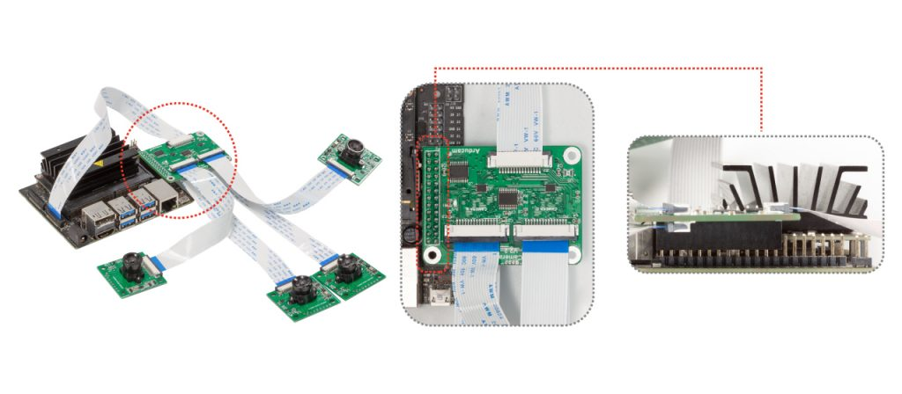
8 MULTI CAMERA SUPPORT ON JETSON NANO
The multi-camera adapter board allows you to connect 4 cameras to a single CSI interface it works on the Jetson nano. The basic principle of this multi-camera adapter board is multiplex 4 MIPI cameras and output one camera image data at a time
Now the jetson nano sends regular images from each lane from the 4 lanes for a regular intervals and the computation of vehicle detection and the signal switching logic is computed on cloud and we get the output as signal and timer to the jetson which performs signal switching and updates timer display

Slide 14
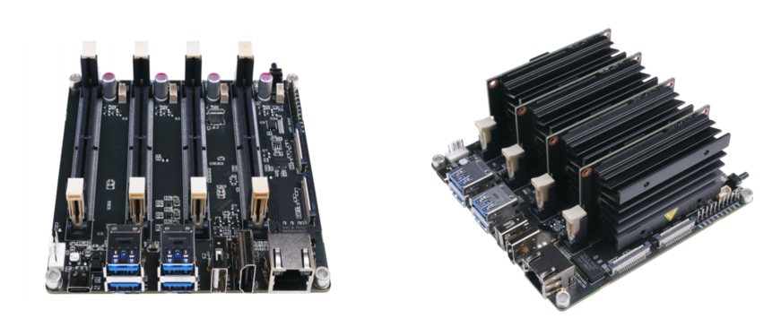
9 JETSON MATE
Jetson NANO development kit supports a single 2-lane camera. We need custom carrier board for jetson NANO module to connect multiple cameras 3 x 4-lane or 4 x 2-lane cameras .
Alternate way is we can use Jetson Mate which can carry upto 4 NVIDIA Jetson Nano/NX SoMs

Slide 15
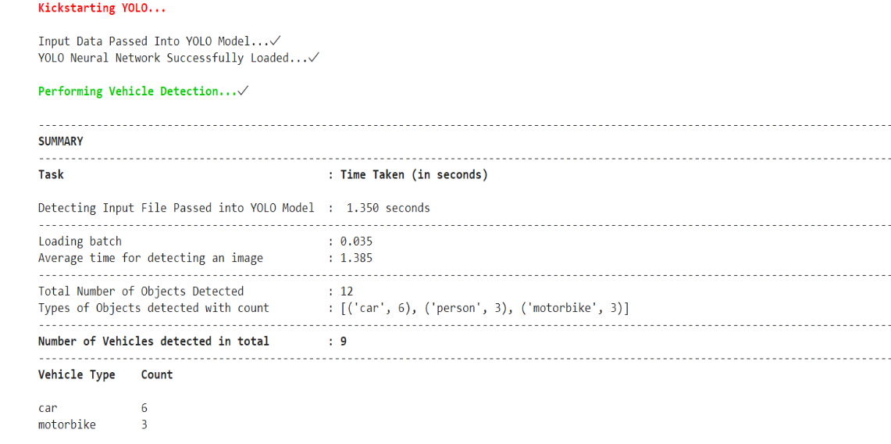

Slide 16
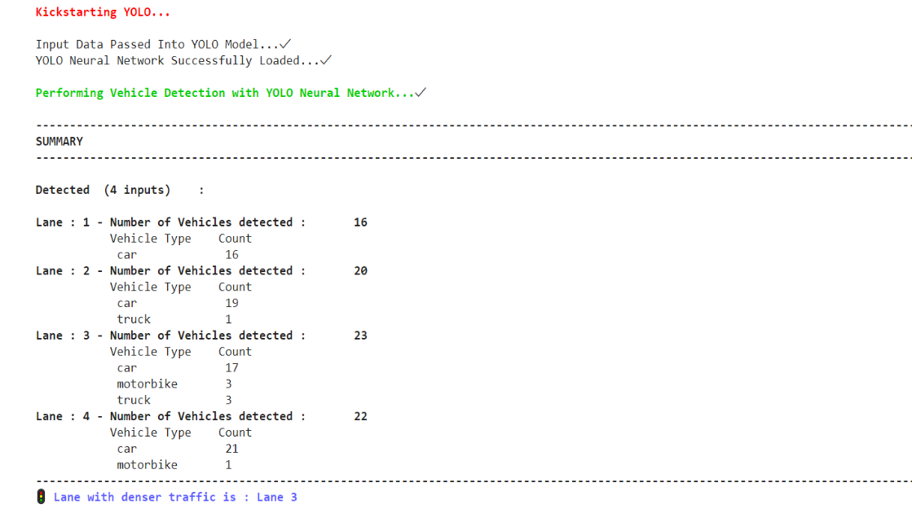

Slide 17
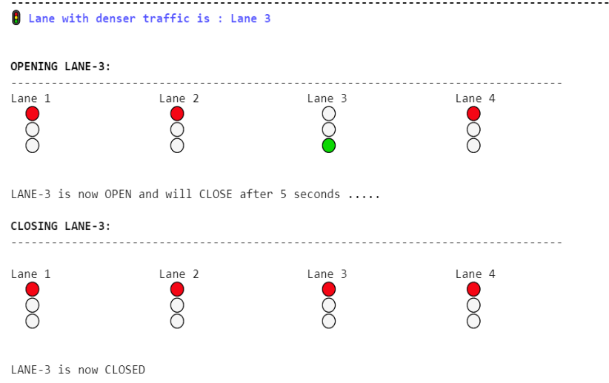

Slide 18
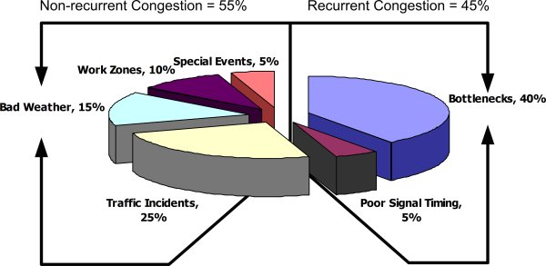
10 PROJECT OUTCOME :
Almost 55% of the congestion can't be controlled, and is non recurrent,
In the 45% which can be controlled
1)physical bottlenecks(“capacity”) … 40%
2)poor signal timing … 5%
We wish to solve the poor signal timing problem, even though 5% looks like a small percentage the amount of delay in journeys and loss to business is huge.
By using our ITS we wish to reduce the congestion,
On successful implementation of the project we can expect less frustrated vehicle drivers, better management of fuel, less CO2 emissions, better business environment. And improve people's ability to access facilities and services.

Slide 19
CONTRIBUTIONS :
CS18B001
1)Studied implementation of ML based signal switching.
2) Refined data yolo v4for vehicle detection specialization.
3)Implemented signal switching based on congestion.
4)Hardware Assembly ideology
CS18B004
1) Studied Few Research Papers to understand the working of YOLO with hardware.
2) Discussion on how to change the data set to specialise in vehicle detection.
3)Hardware Assembly ideology.
CS18B019
1) Studied Few Research Papers to understand the working of YOLO with hardware.
2) Discussion on how to change the data set to specialise in vehicle detection.
3)partially implemented signal switching based on congestion

Slide 20
THANK YOU!

Slide 21
We all want to solve traffic problems but nobody wants to pay for it.We need to bite the bullet and get these projects done.

